Slide 1
Amazon Home Services Introducting AsapTutor
Presenter: Charles Ding
Notes:
Hello everyone, thanks giving me the opportunity to be able to pitch AsapTutor to you guys. My name is Charles and I’ll dive right right in!

Slide 2



What is AsapTutor?
Scalable and Extensible Academia Marketplace
Appointment
Real-Time
Notes:
AsapTutor is a scalable and extensible platform that has the functionality to accommodate both appointments and real-time demand for services.

Slide 3









AsapTutor Cutting Edge Technologies
Amazon EC2 Instance Running NodeJS Server
AWS CloudFront and AWS Route 53 – Web Hosting
AWS S3 – Chatting Storage
SendGrid – Email Notifications
Twillio – Mobile Notifications
Braintree – Secure Payment Integration
Firebase – Real-time Database Management
Notes:
We used only the most reliable and scalable cutting edge technologies for this prototype. As you can see, we have aws, nodejs, firebase, and so on.

Slide 4
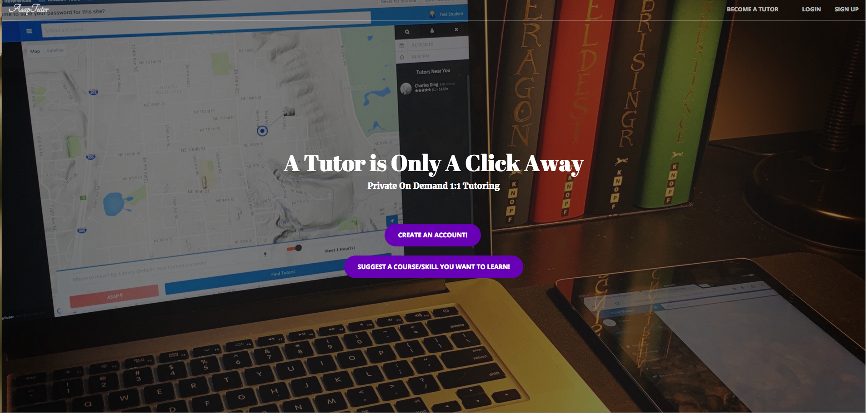
Academic Platform DEMO
Student Perspective: http://asaptutor.us/homePage.html
Tutor Perspective: http://asaptutor.us/tutor.html
Notes:
I’ll go ahead and dive into the demo! It’s a prototype that’s focused on the Academic tutoring market.

Slide 5


Extensibility
Notes:
For now, we focus on Academics, but this platform can be easily extended to any type of service.

Slide 6
Major Features Overview – Questions?
Real-time tracking and real-time visual cues
Real-time status updates/notifications for Mobile and Web
Flexible Scheduling
Chatting Functionality
Credit-Card and PayPal Payment Processing
User Rating
Emergency “ASAP” Button
Notes:
To recap, these are the major feature that asaptutor platform provides Thanks for listening. I’ll go ahead and open the floor to questions.

